Slide 1
Engineering Presentation · April 2026
Gringotts
A Ledger-First Payment Orchestration System
for Citation Payment Processing
Scope — Payments, Obligations, Audit
Replaces — Victor · IMP · Report Manager
Stack — Python · FastAPI · PostgreSQL

Slide 2
01
Current System
A review of how citation payments work today across Victor, IMP, and Report Manager
— and the hidden risks buried in each service.

Slide 3
Current System — How Payments Work Today
In-Person (Victor)
Online (Stripe | Victor )
Check (IMP)
Financial Reports
charge.succeeded webhook
↓ validate sig + dedupe on stripe_event_id
Enrich Stripe Data
↓ amount_paid += captured - convenience_fee
Mutate Citations directly
↓ amount_paid ≥ due_amount?
PAID
POST /add-mail-with-urls
↓ validate citation exists
CheckbookCheckDetails(amount=4000)
↓ deposited_at = cleared_at = now()
Mutate Citations directly
CitationActivityLog created ✓
Multi-process daemon. Queries Stripe + Checkbook + Citations
tables every 4 hrs. Generates CSV → S3.
Stack: FastAPI · Pandas · S3
PUT /mark-paid-in-person
↓ validate user.customer == citation.customer
Mutate Citations directly
amount_paid = due_amount ✓
payment_source = "in_person"
✓ Deduplicates on stripe_event_id
✓ Saves raw webhook to S3
✕ No CitationActivityLog
✕ Invisible to reporting in case of refunds
✕ Amount always $40 — hardcoded
✕ Deposited = Cleared = now()
✕ No rollback if check returned
✕ Produced from vendor_specific tables using multiple joins and varying conditions

Slide 4
Current System — What's Broken
Auditability & Reporting
Maintainability & Enhancement
✕ Audit trail is incomplete and inconsistent
IMP creates CitationActivityLog for most workflows. Victor creates none —
In-person payment audit needs support of system logs to support audits
✕ Reports join drifting tables
Report Manager joins StripePaymentCharges, CheckbookCheckDetails, and Citations
— sources that can fall out of sync.
✕ Business logic scattered across services
Payment rules live in Victor's webhook controller, IMP's Flask routes, Backbone Api
✕ Vendor Lock In
Business Logic & Implementation integrated within Vendor Ecosystem.
Difficult to add additional vendors
✕ Payments Directly Coupled with Individual Citations
Payments can only be received against an individual citation.
Bulk Payments support is built using a workaround rather than the system’s inherent ability to support it
Additional Payments like Flag Payments Cannot be Supported.
Online Payment: 1 Citation => 1 Transaction
High vendor fees
Temporary saving of credit card information on Stripe ( safe but an issue of optics )
Incomplete Payment during Bulk Payments for reasons like insufficient funds
Financial Correctness
✕ No immutable ledger
All balances live in mutable Citations fields.
✕ Hardcoded check amount ($40) + wrong timestamps
IMP always records $40 regardless of the actual check. check_deposited_at
Refunds cannot be supported by checks
✕ In-person leaves no financial record
Victor mutates the citation but creates no payment record.
In case of reversal, Citation record has to be updated

Slide 5
02
Gringotts
A ledger-first, event-driven payment orchestration system built on
immutability, auditability, and clean separation of concerns.

Slide 6
Gringotts — Design Philosophy
Ledger is Source of Truth
Immutability Over Mutation
Event-Driven State
All balances are derived from immutable ledger entries.
Citation fields and cart statuses are computed, never authoritative.
Financial history is append-only. No overwriting. A full payment
timeline is reconstructable from the ledger alone.
Vendor signals (Stripe webhooks, CheckAlt drops) drive state transitions
asynchronously. The API never waits for vendors.
Idempotency by Default
Vendor Agnostic
Full Auditability
Every processor is safe to replay. Duplicate webhook delivery, queue
retries, or manual replays produce the same result.
Core event processor has zero vendor imports. Adding a new payment
processor means adding one vendor module.
Every state change produces an AuditLog with before/after snapshots
and correlation IDs linking related events.
Intent Layer
Processing Layer
Derived State
→
→
API + Cart
Events + Ledger
Carts + Obligations + Citations

Slide 7
Core Data Models
Obligation
Cart
What someone owes. One per citation fee, late fee,
flagging fee, or convenience fee.
Groups obligations for a single payment intent.
One Stripe charge per cart — not per citation.
One Check per cart - 2 check records are not created against a check of $80
amount: original owed
allocated_total: sum of settled ledger allocations
outstanding_amount = amount − allocated_total
overpaid_amount: if allocated > amount
waived_amount: forgiven (not paid)
status: open ↔ locked → closed
(↓ waived, ↓ superseded, ↓ disputed)
draft → checkout → payment_submitted
→ payment_confirmed → payment_settled
(↓ abandoned, ↓ disputed → won/lost)
Ledger
VendorEvent
Append-only. Every payment event recorded here
with allocations to specific obligations.
Normalized inbound signal from Stripe/CheckAlt.
Drives all state transitions.
stage: payment_confirmed / settled / refunded / dispute_*
allocations: [{cart_item, obligation_id, amount}]
Each obligation's allocated_total = SUM(its allocations)
event_type: payment_confirmed / settled / refunded / dispute_*
transaction: normalized payment data

Slide 8
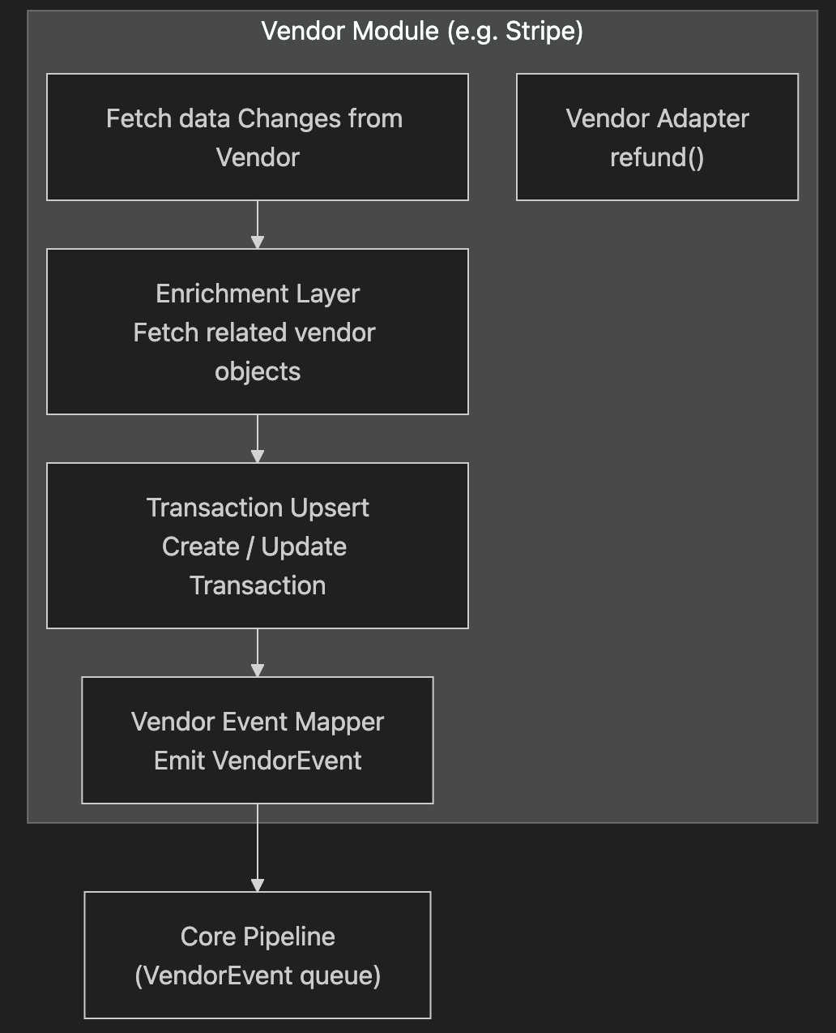
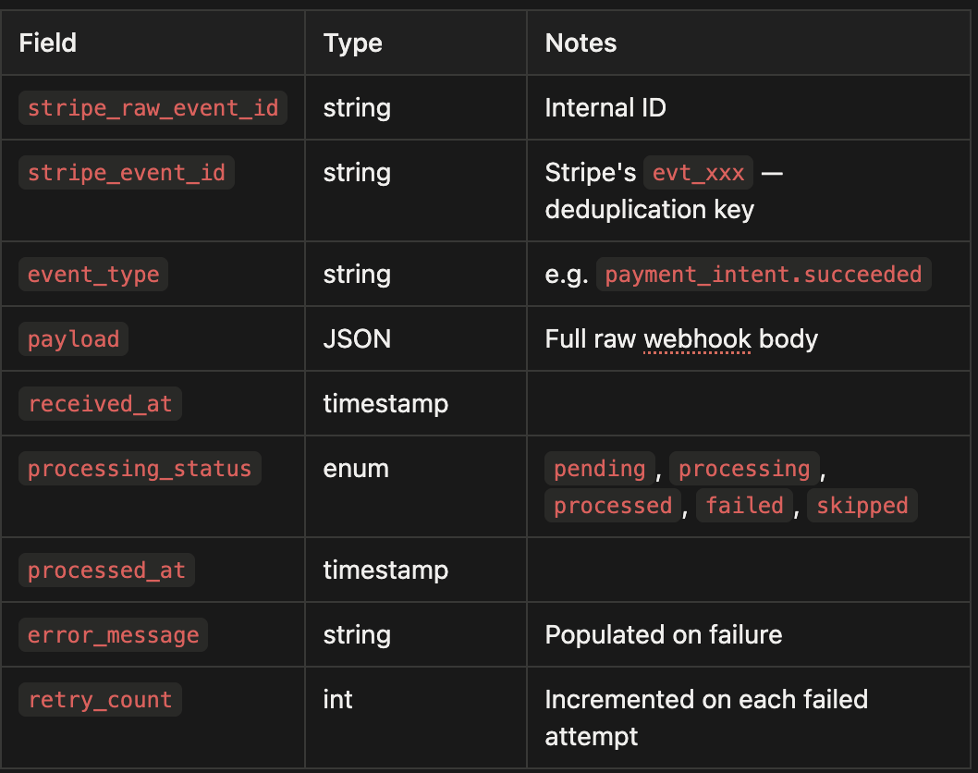
Vendor Integration ( Stripe )
Stripe Raw Events

Slide 9
Online Payment Flow (Stripe)
Synchronous (User-Facing API)
Asynchronous (Event Worker)
POST /checkout → Create cart (draft → checkout)
Create Cart -> Add Obligations
POST /submit → 202 Accepted
Vendor -> submit_payment
Cart → payment_submitted. Obligations locked.
① Stripe webhook received — validated + deduplicated on stripe_event_id
② Transaction upsert — normalize Stripe charge into vendor-agnostic Transaction
③ VendorEvent created — type: payment_confirmed. Enqueued for processing.
④ EventProcessor runs :
Pass 1: Resolve allocations to obligations
Pass 2: Attach cart items → record in ledger
⑤ Derived state updated — Cart → payment_confirmed.
Obligation balances recalculated from ledger.
Citation payments and payment status recalculated from its Obligations
Key Differences
✓ Custom Checkout Pages - Stripe Default Checkout Page is no longer used
✓ One charge per cart (not per citation) — Violator pays all citations in one Stripe charge. Fewer transactions = lower fees.
✓ Ledger is updated, not Citations table — Obligation balances derived from ledger allocations. Citation balances from Obligations
✓ Full idempotency — Processing the same webhook twice yields the same ledger state. Safe to replay.

Slide 10
Check & In-Person Payment Flow (Proposed)
Vendor events carry the actual check amount — no hardcoding. Future integration with CheckAlt or any mail processor uses the same pipeline.
1
Check vendor event ingested
2
VendorEvent created (no pre-existing cart)
3
EventProcessor
4
Ledger records actual payment amount
5
Partial payment? Supported natively.
Contains citation reference, actual amount, check metadata.
Vendor module normalizes into a VendorEvent.
Allocations are payable type: (owner_id, owner_type, label)
— resolved dynamically.
Resolves payable allocations → finds matching open obligation.
Creates system_created cart on-the-fly.
Deposited and cleared timestamps tracked separately.
Obligation balance recalculated from ledger.
Multiple checks can partially pay one obligation.
Each adds a ledger allocation. Obligation closes when outstanding = 0.
IMP vs Gringotts: Check & In-Person
Aspect | Today (IMP / Victor) | Gringotts
Check amount | Always $40 (hardcoded in IMP) | Actual amount from vendor event
Partial payments | Not supported | Supported natively
Returned checks | No financial rollback | Refund event reverses ledger allocation
Audit trail | CitationActivityLog (partial) | Full ledger + AuditLog with before/after
In-person record | None — invisible to reporting | VendorEvent + ledger entry; full audit trail
Duplicate safety | No deduplication key (IMP) | Deduped on vendor event ID

Slide 11
Obligation Operations (Support Actions)
Gringotts supports three first-class operations for adjusting obligations — all with full audit trails.
Waive
Partial Waive
Supersede
Forgive Unpaid Debt
Forgive Remaining Balance
Replace at New Amount
For unpaid obligations (no prior payments).
For partially-paid obligations.
For open obligations with no prior payments.
Precondition: allocated_total == 0
status = WAIVED (terminal)
Use case: Court grants hardship exemption.
Obligation forgiven without any payment.
Precondition: allocated_total > 0 AND outstanding > 0
Effect: waived_amount += outstanding = Total obligation Amount
status = CLOSED
Use case: Paid $20 of $40.
Obvio forgives remaining $20.
Precondition: status == OPEN AND allocated_total == 0
Effect: old obligation → SUPERSEDED
new obligation: amount = new_amount
status = OPEN
Use case: Court revises fine from $40 to $20.
Both old and new in audit trail.
All operations produce AuditLog entries with full before/after snapshots and correlation IDs. Support staff can trace every obligation change to a specific action and actor.

Slide 12
Gringotts — System Architecture
┌────────────────────────────────────────────────────────────────────┐
│ USER / SUPPORT LAYER │
│ Public API Internal Support API │
│ POST /checkout → 201 POST /refunds → 202 │
│ POST /submit → 202 POST /obligations/{id}/waive │
│ GET /reports/ledger │
└──────────────────┬──────────────────────────┬──────────────────────┘
│ (sync, returns fast) │
↓ ↓
┌────────────────────┐ ┌────────────────────────┐
│ CartProcessor │ │ RefundProcessor │
│ create_cart │ │ Dequeue refund request│
│ checkout_cart │ │ Call VendorAdapter │
│ submit → lock │ │ Emit payment_refunded │
└──────────┬─────────┘ └────────────────────────┘
│
┌──────────┴─────────────────────────────────────────────────┐
│ VENDOR EVENT QUEUE │
│ (Stripe webhooks · CheckAlt drops · Court API) │
│ Deduplicated by vendor_event_id │
└──────────────────────────┬─────────────────────────────────┘
│
↓
┌──────────────────────────────────────┐
│ EventProcessor (Core Engine) │ ┌────────────────────┐
│ Pass 1: Resolve allocations │ │ Triage Processor │
│ → CART_ITEM: find CartItem │ │ Detect Anomalies │
│ → PAYABLE: match (owner,label)│ │ -> TriageRequest │
│ Pass 2: Attach cart items │─────Triage Queue────> │ │
│ → Ledger.record_event() │ └────────────────────┘
└────────────┬─────────────────────────┘
│
┌────────────────┼────────────────┐─────────────────┐
↓ ↓ ↓ ↓
┌───────────┐ ┌────────────┐ ┌────────────────┐ ┌────────────────┐
│ Ledger │ │ Carts │ │ Obligations │ │ Citations │
│ (Append │ │ (Derived) │ │ (Derived) │ │ (Derived) │
│ Only) │ └────────────┘ └────────────────┘ └────────────────┘
└─────────────┘

Slide 13
03
Support UI
How support staff will interact with the Gringotts system —
citation lookup, payment history, refunds, obligation adjustments, and audit logs.

Slide 14
Support UI — Citation Payment Overview
Support staff search by citation number. Single pane shows full financial state.
Citation #000322452
⚡ Payment Overview
Citation Type
Stop Sign
Total Owed
$40.00
📋 Obligation History
Outstanding
$20.00
Status
PARTIALLY PAID
📦 Cart Detail
Obligations
Label | Amount | Paid | Outstanding | Status | Action
Citation Fee (OBL-3) | $40.00 | $20.00 | $20.00 | OPEN | Waive ↗
Check (42/1) | cart:4 | $20.00 paid | — | SETTLED | —
📒 Ledger Entries
🔍 Audit Log
↩ Refunds
Key feature: Per-obligation status. Actions available inline based on state. Outstanding amount always derived from ledger — never stale.

Slide 15
Support UI — Obligation & Cart Sample Data
Obligations — Citations 000331714 & 000329181
Cart — 1
One obligation per fee type. Balances are always derived from ledger allocations.
One cart per checkout session. Groups all obligations into a single vendor charge.
id | label | amount | allocated | outstanding | status
1 | citation_fee | $40.00 | $40.00 | $0.00 | CLOSED
2 | citation_fee | $40.00 | $80.00 | $0.00 | CLOSED (+$40 overpaid)
9 | convenience_fee | $4.00 | $4.00 | $0.00 | CLOSED
id
1
status
payment_settled
payment_mode
online
vendor
stripe
How outstanding_amount is computed:
amount
$84.00
OBL-1: allocated($40) − amount($40) = $0 → CLOSED
OBL-2: allocated($80) − amount($40) = overpaid $40, outstanding=$0 → CLOSED
OBL-9: allocated($4) − amount($4) = $0 → CLOSED
refund_amount
$40.00
vendor_ref
txn_3RKstt…S1G9OXSH1
created_at
2026-03-24 11:56:15Z
Cart Items:
item | obligation | label | amount
CI-1 | OBL-9 | convenience_fee | $4.00
CI-2 | OBL-1 | citation_fee (000331714) | $40.00
CI-3 | OBL-2 | citation_fee (000329181) | $40.00
OBL-2 shows $80 allocated — paid by both Stripe and CheckAlt, resulting in $40 overpayment.

Slide 16
Support UI — Ledger: Data Transitions
The ledger is append-only. Each vendor event adds rows — obligation balances recalculated from running total of allocations.
State 1: payment_confirmed (11:56:29Z)
State 2: payment_settled (11:56:33Z)
State 3: payment_refunded (11:57:21Z)
Stripe webhook received. Funds not yet settled.
Stripe charge clears. Stage updated in-place on existing rows.
New ledger item appended — nothing overwritten.
Ledger Records
ldg_id | stage | label | amount
LDG-1 | SETTLED | cart_payment (prior) | $84.00
LDG-2 | SETTLED | stripe_fee (prior) | -$1.55
LDG-7 | REFUNDED | refund_payment | -$40.00
ldg_id | stage | label | amount
LDG-1 | CONFIRMED | cart_payment | $84.00
Ledger Records
ldg_id | stage | label | amount
LDG-1 | SETTLED | cart_payment | $84.00
LDG-2 | SETTLED | stripe_fee | -$1.55
LDG-2 | CONFIRMED | stripe_fee | -$1.55
Ledger Allocations
Ledger Allocations ( No Change)
ldg_id | Cart Item id | label | amount
LDG-1 | CI-1 | citation_fee | $40.00
LDG-1 | CI-2 | citation_fee | $40.00
LDG-1 | CI-3 | conv_fee | $4.00
ldg_id | Cart Item id | label | amount
LDG-1 | CI-1 | citation_fee | $40.00
LDG-1 | CI-2 | citation_fee | $40.00
LDG-1 | CI-3 | conv_fee | $4.00
Ledger Allocations ( No Change)
ldg_id | Cart Item id | label | amount
LDG-7 | CI-1 | citation_fee | $40.00
Key insight: The ledger is never overwritten. Refunds are new rows. Obligation.outstanding_amount = SUM of all ledger allocations — always derivable, always correct.

Slide 17
Support UI — Access Log & Audit Log
Access Log
Audit Log
Every HTTP request and worker execution. Operational observability — latency, errors, actors.
Every domain-level state change with before/after snapshots. Full traceability for any payment complaint.
── request ─────────────────────────────────────
channel: http
request_id: req_submit_1_1774353383900
correlation_id: cart_payment:1
actor_type: user / actor_id: demo_user
method: POST /payments/submit
status_code: 202 / duration_ms: 1
timestamp: 2026-03-24T11:56:23Z
── worker ──────────────────────────────────────
channel: worker
request_id: worker_event:1
correlation_id: cart_payment:1
causation_id: vendor_event:1
method: process_payment_event
status_code: 200 / duration_ms: 94
timestamp: 2026-03-24T11:56:29Z
── obligation_status_changed ─────────────────
entity_type: obligation
action: obligation.payment_confirmed
entity_id: 1 (000331714)
old_status: LOCKED / new_status: CLOSED
before: {"outstanding": 4000, "allocated": 0}
after: {"outstanding": 0, "allocated": 4000}
correlation_id: cart_payment:1
causation_id: vendor_event:1
timestamp: 2026-03-24T11:56:29Z
── cart_status_changed ───────────────────────
entity_type: cart / entity_id: 1
Action: cart.payment_settled
old_status: payment_confirmed
new_status: payment_settled
correlation_id: cart_payment:1
causation_id: vendor_event:2
timestamp: 2026-03-24T11:56:33Z
Tracing a complaint: Citation 000331714 → OBL-1 → Cart 1 → cart_payment:1 → all access logs + audit logs for the full flow (checkout, submit, confirmed, settled, refund) across HTTP and worker execution.

Slide 18
Support UI — Initiating a Refund
Support staff select a settled cart, choose items to refund, and submit. The system handles the rest asynchronously.
Refund Form (Cart 1)
What happens after Submit:
Cart Status: payment_settled · Stripe · 2026-03-24 · $84.00
①
Refund record created → 202
Select Items to Refund:
UI shows 'Refund Requested'. AuditLog entry: refund_created.
☑ Citation Fee · OBL-1 (000331714) · CI-2 · $40.00
②
Refund Processor dequeues
☐ Convenience Fee · OBL-9 · CI-1 · $4.00
Calls VendorAdapter.refund(cart, items) → Stripe API.
Refund amount:
$40.00
③
Stripe emits charge.refunded
Method:
Stripe (original payment method)
EventProcessor receives as payment_refunded VendorEvent.
Reason:
Duplicate charge
④
Ledger appends LDG-7 (refunded)
Submit Refund →
Allocation: -$40 against OBL-1. outstanding_amount → $40 → status OPEN.
⑤
Cart.refund_amount += $40
Cart stays payment_settled. Refund is a ledger event, not a status change.
Cart items are refunded in full only. Pick specific items to achieve a partial refund of the overall cart.

Slide 19
Support UI — Obligation Adjustment
Adjustment Form (OBL-5 · 000328981 · citation_fee · $40.00)
Available actions by state:
Current State:
State | Waive | Partial Waive | Supersede
OPEN (unpaid) | ✓ Available | ✕ Not available | ✓ Available
OPEN (partial paid) | ✕ | ✓ Available | ✕
WAIVED | ✕ | ✕ | ✕
id:
5 (000328981)
label:
citation_fee
amount:
$40.00
allocated_total:
$0.00
outstanding_amount:
$40.00
status:
OPEN
What each action writes:
Select Action:
# Waive (unpaid)
obligation.waived_amount += $40.00
obligation.outstanding = $0.00
obligation.status = WAIVED (terminal)
# Supersede (creates new obligation)
old_obligation.status = SUPERSEDED (terminal)
new_obligation.amount = new_amount
new_obligation.status = OPEN
☑ Waive — Forgive full $40.00 (unpaid, no prior allocation)
☐ Partial Waive — Requires prior partial payment (disabled)
☐ Supersede — Replace with new amount
Reason: Court-ordered hardship waiver
Apply Waiver →

Slide 20
Online Payment — Full Data Transition (Stripe)
Each step shows the exact state of every entity. All transitions are driven by events — the API returns immediately at step 3.
① POST /checkout
11:56:23Z
② Checkout confirmed
③ POST /submit →202
11:56:23Z
④ payment_confirmed
11:56:29Z
⑤ payment_settled
11:56:33Z
CART 1: draft · $84.00
CI-2→OBL-1 $40
CI-3→OBL-2 $40
CI-1→OBL-9 $4
OBL-1: OPEN · $40 owed
OBL-2: OPEN · $40 owed
LEDGER: empty
CART 1: checkout
vendor_intent_id:
pi_3RKstt…
OBL-1: OPEN
OBL-2: OPEN
LEDGER: empty
CART 1: payment_submitted
OBL-1: LOCKED
locked_by: cart:1
OBL-2: LOCKED
locked_by: cart:1
LEDGER: empty
CART 1: payment_confirmed
OBL-1: CLOSED
allocated: $40
outstanding: $0
OBL-2: CLOSED · $40
LEDGER (event:1):
LDG-1 CONFIRMED $84
→OBL-1 $40
→OBL-2 $40
→OBL-9 $4
LDG-2 fee -$1.55
CART 1: settled
refund_amount: $0
OBL-1: CLOSED
allocated: $40
OBL-2: CLOSED · $40
LEDGER (event:2):
LDG-1 SETTLED
txn_3RKstt…
LDG-2 SETTLED
← In financial reports

Slide 21
Support UI — Cart Activity Log
Append-only log of every cart status transition. Linked to obligations and vendor events via correlation_id.
Cart Activity Log (Cart 1):
timestamp | event | from | to | actor | cause
11:56:15Z | cart.created | — | draft | demo_user | req_checkout_...
11:56:15Z | cart.items_added | draft | draft | demo_user | req_checkout_...
11:56:23Z | cart.checked_out | draft | checkout | demo_user | req_checkout_...
11:56:23Z | cart.payment_submitted | checkout | submitted | demo_user | req_submit_1_...
11:56:29Z | cart.payment_confirmed | submitted | confirmed | worker | vendor_event:1
11:56:33Z | cart.payment_settled | confirmed | settled | worker | vendor_event:2
CartActivityLog Record Structure:
Support Use
cart_id: 1
event_type: cart.payment_settled
old_status: payment_confirmed
new_status: payment_settled
actor_type: worker
actor_id: worker_event:2
correlation_id: cart_payment:1
causation_id: vendor_event:2
metadata: {"vendor": "stripe", "amount": 8400}
timestamp: 2026-03-24T11:56:33Z
If a violator says 'I paid but my citation still shows unpaid', filter this log by citation → find cart → check whether it reached payment_confirmed.
If stuck at payment_submitted, the vendor event has not arrived yet.
Every cart transition is linked back to the exact request or vendor event that caused it — support staff can trace any payment complaint in one query.

Slide 22
Support UI — Obligation Activity Log
Every balance change and status transition on each obligation — linked to the cart and vendor event that caused it.
Obligation Activity Log (OBL-1 · 000331714 · citation_fee):
timestamp | event | status change | outstanding | allocated | cause
11:56:15Z | obligation.created | — → OPEN | $40.00 | $0.00 | citation_issued
11:56:23Z | obligation.locked | OPEN → LOCKED | $40.00 | $0.00 | cart_item:2
11:56:29Z | obligation.payment_confirmed | LOCKED → CLOSED | $0.00 | $40.00 | vendor_event:1
11:56:33Z | obligation.payment_settled | CLOSED → CLOSED | $0.00 | $40.00 | vendor_event:2
11:57:02Z | obligation.payment_settled | CLOSED → CLOSED | $0.00 | $80.00 +overpaid | checkalt 41/1
11:57:21Z | obligation.payment_refunded | CLOSED → CLOSED | $0.00 | $40.00 (−$40) | vendor_event:5
ObligationActivityLog Record Structure:
Support Use
obligation_id: 1 (000331714)
event_type: obligation.payment_refunded
old_status: CLOSED / new_status: CLOSED
old_outstanding: 0 / new_outstanding: 0
old_allocated: 8000 / new_allocated: 4000
allocated_delta: -4000
ledger_entry_id: LDG-7
correlation_id: cart_payment:1
causation_id: vendor_event:5
timestamp: 2026-03-24T11:57:21Z
Answer 'why is this obligation still open?' in one query.
The activity log shows every allocation added and reversed, the ledger entry that caused it, and who/what initiated the change.
Each record has an allocated_delta showing exactly how much was added or removed in that event — no manual arithmetic required.

Slide 23
Support UI — Ledger Report
payment_date | vendor_name | vendor_reference_type | vendor_reference_id | transaction_id | cart_id | payment_mode | type | label | owner_type | owner_id | obligation_id | obligation_label | cart_item_id | amount
2026-03-24 11:56:33 | stripe | stripe_balance_transaction | txn_3RKstt2KVHqqtmaS1G9OXSH1 | 1 | 1 | online | payment | cart_payment | cart | 1 | 9 | convenience_fee | 1 | 400
2026-03-24 11:56:33 | stripe | stripe_balance_transaction | txn_3RKstt2KVHqqtmaS1G9OXSH1 | 1 | 1 | online | payment | cart_payment | citation | 331714 | 1 | citation_fee | 2 | 4000
2026-03-24 11:56:33 | stripe | stripe_balance_transaction | txn_3RKstt2KVHqqtmaS1G9OXSH1 | 1 | 1 | online | payment | cart_payment | citation | 329181 | 2 | citation_fee | 3 | 4000
2026-03-24 11:56:33 | stripe | stripe_balance_transaction | txn_3RKstt2KVHqqtmaS1G9OXSH1 | 1 | 1 | online | fee | stripe_fee |  |  |  |  |  | -155.0
2026-03-24 11:56:33 | stripe | stripe_balance_transaction | txn_3RKstt2KVHqqtmaS1G9OXSH1 | 5 | 2 | online | payment | cart_payment | cart | 2 | 10 | convenience_fee | 4 | 400
2026-03-24 11:56:33 | stripe | stripe_balance_transaction | txn_3RKstt2KVHqqtmaS1G9OXSH1 | 5 | 2 | online | payment | cart_payment | citation | 330575 | 7 | citation_fee | 5 | 4000
2026-03-24 11:56:33 | stripe | stripe_balance_transaction | txn_3RKstt2KVHqqtmaS1G9OXSH1 | 5 | 2 | online | payment | cart_payment | citation | 330362 | 8 | citation_fee | 6 | 4000
2026-03-24 11:56:33 | stripe | stripe_balance_transaction | txn_3RKstt2KVHqqtmaS1G9OXSH1 | 5 | 2 | online | fee | stripe_fee |  |  |  |  |  | -155.0
2026-03-24 11:57:02 | checkalt | transaction | 41/1 | 2 | 3 | check | payment | check_payment | citation | 331714 | 1 | citation_fee | 7 | 4000
2026-03-24 11:57:02 | checkalt | transaction | 41/1 | 2 | 3 | check | payment | check_payment | citation | 329181 | 2 | citation_fee | 8 | 4000
2026-03-24 11:57:07 | checkalt | transaction | 42/1 | 3 | 4 | check | payment | check_payment | citation | 322452 | 3 | citation_fee | 9 | 2000

Slide 24
Support UI — Ledger Report
2026-03-24 11:57:21 | stripe | stripe_balance_transaction | txn_3RKstt2KVHqqtmaS138WeBtC | 4 | 1 | online | payment | refund_payment | citation | 331714 | 1 | citation_fee | 2 | -4000
2026-03-24 11:57:28 | stripe | stripe_balance_transaction | txn_1STPXu2KVHqqtmaSJLAyVZ2G | 6 | 2 | online | payment | dispute_payment | cart | 2 | 10 | convenience_fee | 4 | -400
2026-03-24 11:57:28 | stripe | stripe_balance_transaction | txn_1STPXu2KVHqqtmaSJLAyVZ2G | 6 | 2 | online | payment | dispute_payment | citation | 330575 | 7 | citation_fee | 5 | -4000
2026-03-24 11:57:28 | stripe | stripe_balance_transaction | txn_1STPXu2KVHqqtmaSJLAyVZ2G | 6 | 2 | online | payment | dispute_payment | citation | 330362 | 8 | citation_fee | 6 | -4000
2026-03-24 11:57:28 | stripe | stripe_balance_transaction | txn_1STPXu2KVHqqtmaSJLAyVZ2G | 6 | 2 | online | fee | stripe_fee |  |  |  |  |  | -1500.0
2026-03-24 11:57:28 | stripe | stripe_balance_transaction | txn_1STPXu2KVHqqtmaSJLAyVZ2G | 6 | 2 | online | payment | dispute_payment | cart | 2 | 10 | convenience_fee | 4 | -400
2026-03-24 11:57:28 | stripe | stripe_balance_transaction | txn_1STPXu2KVHqqtmaSJLAyVZ2G | 6 | 2 | online | payment | dispute_payment | citation | 330575 | 7 | citation_fee | 5 | -4000
2026-03-24 11:57:28 | stripe | stripe_balance_transaction | txn_1STPXu2KVHqqtmaSJLAyVZ2G | 6 | 2 | online | payment | dispute_payment | citation | 330362 | 8 | citation_fee | 6 | -4000
2026-03-24 11:57:28 | stripe | stripe_balance_transaction | txn_1STPXu2KVHqqtmaSJLAyVZ2G | 6 | 2 | online | fee | stripe_fee |  |  |  |  |  | -1500.0
2026-03-24 11:57:28 | stripe | stripe_balance_transaction | txn_1STPXu2KVHqqtmaSJLAyVZ123 | 7 | 2 | online | payment | dispute_reversal_payment | cart | 2 | 10 | convenience_fee | 4 | 400
2026-03-24 11:57:28 | stripe | stripe_balance_transaction | txn_1STPXu2KVHqqtmaSJLAyVZ123 | 7 | 2 | online | payment | dispute_reversal_payment | citation | 330575 | 7 | citation_fee | 5 | 4000
2026-03-24 11:57:28 | stripe | stripe_balance_transaction | txn_1STPXu2KVHqqtmaSJLAyVZ123 | 7 | 2 | online | payment | dispute_reversal_payment | citation | 330362 | 8 | citation_fee | 6 | 4000

Slide 25
Support UI — Triage System
Centralized queue for support staff to flag, investigate, and resolve payment anomalies.
Triage Queue (4 open items):
priority | type | citation | cart | detail | assigned | status
MED | overpayment | 000329181 | 1,3 | Paid by Stripe + CheckAlt ($40 over) | — | open
MED | partial_payment | 000322452 | 4 | Check paid $20, still owes $20 | james.r | in_progress
LOW | refund_open | 000331714 | 1 | Stripe refund issued, OBL-1 still OPEN | — | open
Triage Item Detail: CRT-449 — Stuck Payment
Cart submitted: Mar 13 09:22Z
Status: payment_submitted (48+ hrs)
Stripe intent: pi_3Px7Rb... → requires_action
Last access log: req_4mNx1k (submit)
Triage item types & auto-detection:
Type | Detection Rule | Action
stuck_payment | Cart in payment_submitted > 24 hrs | Check Stripe intent status. Cancel + reopen if needed.
refund_failed | Refund processor errors ≥ 3 attempts | Manual Stripe refund. Mark processed.
balance_mismatch | Obligation outstanding > 0 but cart settled | Inspect ledger entries. Refund if needed
vendor_event_failed | VendorEvent processing_status = failed | Inspect error, fix root cause, replay event.

Slide 26
Current vs Proposed — Head-to-Head
Capability | Current System (Victor + IMP) | Gringotts
Financial source of truth | Mutable Citations fields — can drift from actual payments | Immutable ledger — every balance derived from append-only entries
Refund handling | citation_amount_paid never decremented. Balance wrong after refund. | Refund event creates negative ledger allocation. Obligation reopens automatically.
Check amounts | Always $40 (hardcoded in IMP regardless of actual check) | Actual amount from vendor event data (no hardcoding)
Partial payments | Not supported for checks. | Native support. Multiple payments accumulate in ledger allocations.
Dispute (chargeback) | No chargeback lifecycle. Refund tracked but balance not reversed. | Full disputed → won/lost lifecycle with ledger stage tracking.
Audit trail | IMP creates activity logs. Victor does not. S3 has raw JSONs. | Every state change logged with before/after + correlation/causation IDs.
Idempotency | Victor dedupes on stripe_event_id. IMP has no deduplication. | All event processors deduplicate. Ledger identifies duplicate entries.
Multi-citation checkout | One Stripe charge per citation | One cart = one Stripe charge for N citations. Lower fees.
In-person payment record | No financial record created. Invisible to support and reporting. | VendorEvent + ledger entry created. Fully auditable.
Financial reporting | Report Manager joins multiple tables that can drift. In-person never appears. | Single ledger query. All payment modes in one consistent source.

Slide 27
Migration Strategy
· No big-bang cutover — phased by payment mode
· Run in parallel during transition (dual-write if needed)
· Existing citations backfilled into Gringotts obligations
· Victor and IMP remain active for legacy citations until fully migrated
Phase 1
Phase 2
Phase 3
Gringotts Infrastructure
Online Payments (Stripe)
Check Payments + Reports
1. Deploy Gringotts alongside existing services — Ledger, Obligation, Cart, VendorEvent tables created. No traffic yet.
2. Backfill existing citations as Obligations — Open citations → OPEN obligations. Paid citations → CLOSED obligations with synthetic ledger entries.
1. Route new Stripe webhooks to Gringotts — Victor reads events; Gringotts processes them. Dual-write until validated.
2. New checkouts create Gringotts Carts — Public API updated to use POST /checkout + POST /submit.
3. Decommission Victor's payment logic — Victor becomes a thin webhook receiver only.
1. Route CheckAlt events to Gringotts — IMP replaced by Gringotts CheckAlt vendor module.
2. Replace Report Manager with ledger queries — GET /reports/ledger replaces CSV generation.
3. Decommission IMP + Report Manager.

